Slide 1

Doctorate in Clinical Psychology:
Clinical Placements
Dr Olwyn Matier
Consultant Clinical Psychologist
Clinical Director, Doctorate in Clinical Psychology

Slide 2
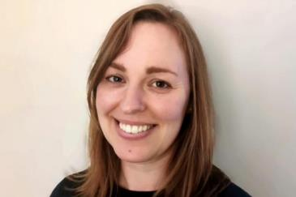
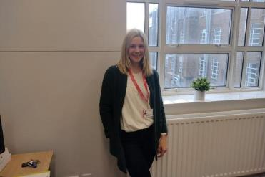
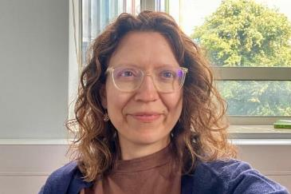

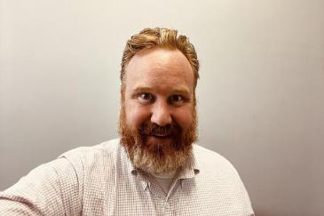


The clinical placement team
Dr Jenny Cross
Clinical teaching fellow
Dr Sharon Frazer
Clinical teaching fellow
Dr Kelly Martinez
Clinical teaching fellow
Dr Olwyn Matier
Clinical Director
o.matier@qub.ac.uk
Dr Annie Melaugh McAteer
Clinical teaching fellow
Dr Alex Rowell
Clinical teaching fellow

Slide 3

Role of clinical placements in training
Substantial component of training.
Promoting effective clinical practice & skills development.
Competency based learning outcomes.
Partnership working with local HSC Trusts.
Engaging, challenging, rewarding, positive learning experience.
Putting into practice HSC values e.g. compassion, excellence, working together.
Contributing to service provision and client wellbeing from outset of training.

Slide 4

Where are the QUB DClinPsy clinical placements?
Regional training course: placements within different HSC Trusts across NI.
Clinical areas
  Varied clinical populations (e.g. adult mental health, child and adolescent services, intellectual disability)
  Varied service types e.g. inpatient/outpatient, MDTs
  Varied approaches for intervention: direct/indirect (carers, other health care professionals), individual/group, therapeutic modalities (e.g. CBT, systemic)
Opportunity to develop own areas of interest and style of working over the course of training.

Slide 5




What do clinical placements involve?
Close supervision of a qualified Clinical Psychologist.
Working clinically with clients across the lifespan.
Aiming to reduce distress, improve quality of life.
Assessment, formulation, intervention.
Broader skill sets and professional issues e.g. understanding professional role, organisational influence, leadership, Equality Diversity and Inclusion, Patient and Public Involvement.

Slide 6





Linking theory and practice
Apply the teaching at Queen’s in clinical work on placement. Theory and research findings should inform clinical practice.
Clinical science in practice – empirically supported psychological interventions. Evaluate treatment.
Trainees bring their clinical experience and observations back into the classroom which can complement teaching / enhance learning.
Reflective scientist-practitioners.

Slide 7
Clinical Placements at QUB
Across the three years of training:
  5 Placements.
  First year has an extended clinical placement.
  The 4 clinical placements in years 2 and 3 are approx. 6 months in duration.
  In placement typically for three days a week during term time and rising to four days during the summer months.

Slide 8
Clinical Placements at QUB
Year 1 | Year 2 | Year 3
1 Placement | 2 Placements | 2 Placements
Adult (presentations commonly seen in adulthood) | A child psychology placement and an intellectual disability placement. | Specialist / elective placements (e.g., Neuropsychology, Forensics, Neonatology, Specialist CAMHS, Specialist Paediatric Psychology, Older Adults, Addictions, psychosis, eating disorders, perinatal, specialist ID, LAC)

Slide 9

Placement planning
Placement planning meetings:
  Clinical population, Modes of working, Psychometric assessment, Primary and secondary therapeutic models
  EDI considerations, Engagement with service users
  Supervision schedule, Plans for mutual observation, Supervision model
  Trainee goals
  Knowledge base/ reading.

Slide 10

Placement monitoring
Mid and end of placement meetings.
Clinical log book.
Progress, strengths, areas for further development.
Trainee feedback and experiences of placement.

Slide 11

Trainee support around placements
Safe and supportive learning environment.
Placement supervisor.
Clinical tutor:
  Consistent point of contact & support
  Placement meetings
  Informal contact when needed
  Getting to know trainees on an individual basis
Clinical director.
Placement panel – trainee representatives.
Importance placed on trainee experience, feedback, wellbeing.

Slide 12
Thank You

